Slide 1
Intro to Wireshark

Slide 2
whoami
Whoami
Matt Fiely
Slack: titan
What I do
Student
Intern in Security Realm

Slide 3
Disclaimer
Do not practice on systems you do not own
Hacking without written consent is illegal
I am not a lawyer
I can’t help if you if you use anything from today for evil
Everything I’m going over today is for educational purposes

Slide 4
What are we doing tonight?
Some Networking basics
Learn about Wireshark
Use Wireshark

Slide 5

Pre reqs
Going to need Wireshark
https://www.wireshark.org/
Download and install
Does come on Kali Linux

Slide 6
What is a Wireshark?
A network protocol analyzer
Allows you to look at packets
FOSS (Free and open source)
Widely used
GUI based
Alternative protocol analyzer
TShark (Terminal based)
Tcpdump - terminal based “competitor”

Slide 7
Before we get started with wireshark...

Slide 8
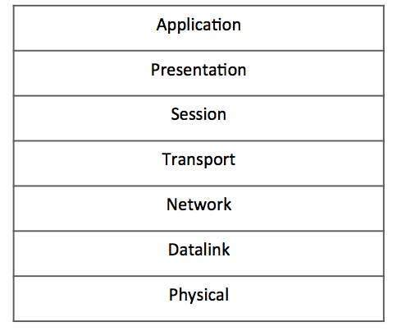
OSI Model
Open System interconnection
Conceptual model for how systems communicate with each other
Layout
7 Layers
Bottom to top 1-7
Please Do Not Throw Stale Pizza Away

Slide 9
OSI Model
Physical
Physical and electrical components of data connection
Ethernet cable, router
Data Link
Direct node-to-node transfer
Network
Identify hosts, defines path
IP addresses, Packets

Slide 10
OSI Model
Transport
Provides end to end data delivery among hosts
Transmission Control Protocol
User Datagram Protocol
Session
Establishes, manages, terminates connections
Cookies
Presentation
Formats data to be sent across the network
Application
What the user interacts with
Web browser

Slide 11
We care about Network for today

Slide 12
What is a packet??
A fixed unit of data, with the intention of transmitting data to another device
The basis of the internet
All data is moved within a packet
HTTP
SSH
FTP
You name it, it’s in a packet
Think about it like an envelope

Slide 13
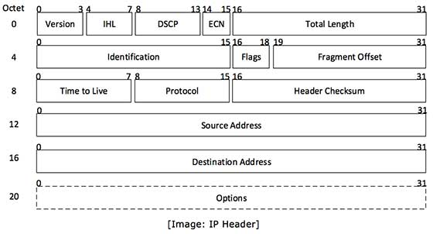
What’s in a packet?
Version
Version no of Internet protocol
IPv4 vs IPv6
Internet Header Length
Length of the entire IP header
Differentiated Service code
AKA Type of Service
Used to specify quality
Total Length
IP header + IP Payload
https://www.tutorialspoint.com/ipv4/images/ip_header.jpg

Slide 14
What’s in a packet?
Identification
Contains an identification number
Utilized if the packet is fragmented during transmission
Flags (3 bits field)
Bit 0
DF - Don’t fragment
MF - More fragment
Fragment offset
States where the next fragment should start
https://www.tutorialspoint.com/ipv4/images/ip_header.jpg

Slide 15
What’s in a packet?
Time to live
Helps prevent packet from living forever
Each number represents a max “hop”
Protocol
Tells destination which protocol to use
TCP, UDP, ICMP
Header checksum
Error-checking
https://www.tutorialspoint.com/ipv4/images/ip_header.jpg

Slide 16
What’s in a packet?
Source Address
Source IP address
Destination Address
Destination IP address
Options
Rarely used
https://www.tutorialspoint.com/ipv4/images/ip_header.jpg

Slide 17
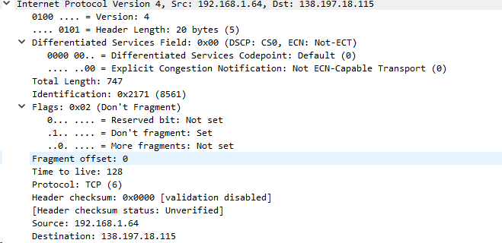
What’s in a packet? (wireshark)

Slide 18
Time for wireshark
Check slack for a .pcap
Double click the file

Slide 19
Let’s make wireshark usable
Edit -> Preference -> Layout -> Option 2 -> OK
This is the format I’ll be using

Slide 20
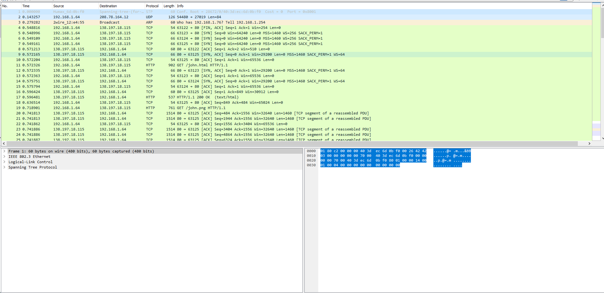
.pcap = Packet Capture
Every line represents a packet
Analyze a packet by clicking on a line
Packet List
Packet Details
Packet Bytes

Slide 21
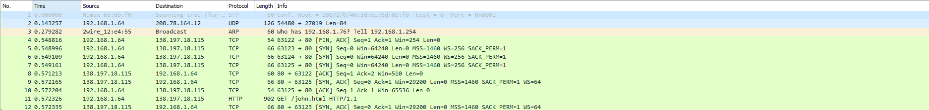
Packet List
No. - Packet number
Time - Time (in seconds)
Source - Source IP address
Destination - Destination IP address
Protocol - Protocol type
Length - Length (byte) of packet
Info - Little Summary

Slide 22

Packet Details
These rows will vary based on protocol
I’m going to be dissecting a HTTP packet

Slide 23
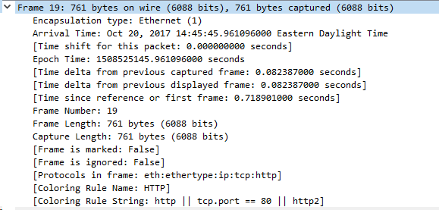
Physical
Arrival time
Time the packet occured
Frame length
Entire packet length
Will be the same as the length in the header

Slide 24

Datalink
Destination MAC Address
Source MAC address
IP Version

Slide 25
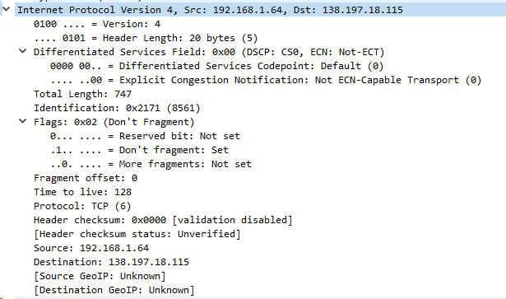
Network
Reviewed this earlier see previous slides

Slide 26
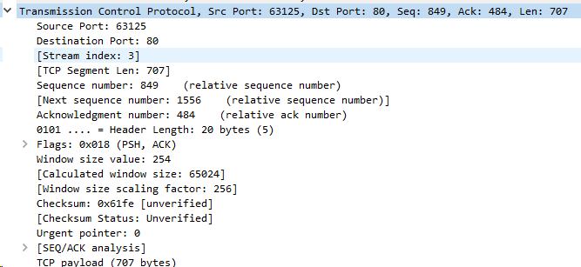
Transport
Source port
Destination port
Sequence number
Transport Flag
TCP Payload

Slide 27
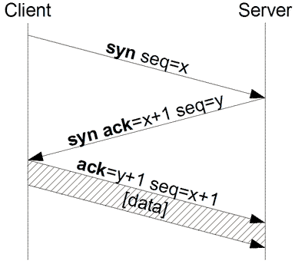
TCP Flags
3-way handshake
SYN
Synchronization
ACK
Acknowledgement
FIN
Finish

Slide 28
TCP Flags (con.)
URG
Urgent
Process before others
PSH
Push
Notify receiver to process as received
RST
Reset
Tell the sender the recipient was not expecting the packet

Slide 29
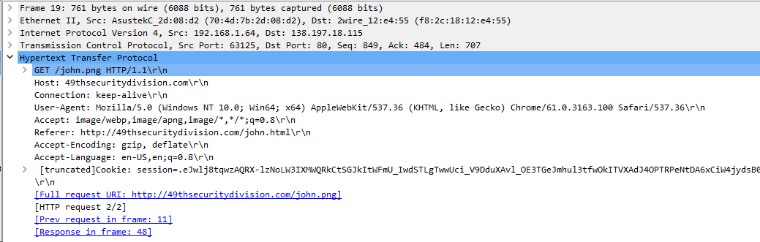
Application
Protocol being used
In this case it is HTTP
Shows the HTTP header

Slide 30
HTTP Methods
GET
Usually to request data from a resource
POST
Usually to submit data to be process
HEAD
PUT
DELETE
CONNECT
OPTIONS

Slide 31
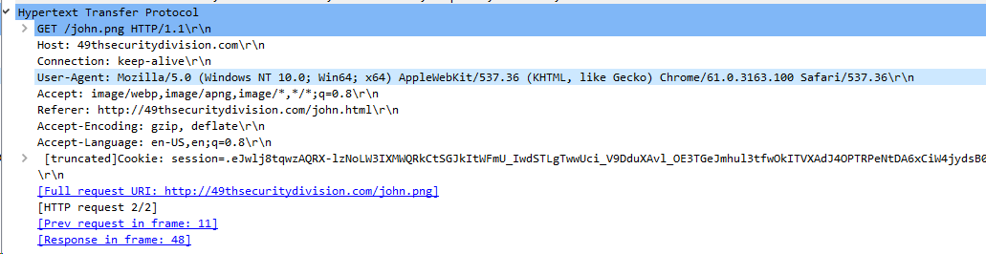
Application
Host
Domain
User-Agent
Tells the server how to return data
This was a question in the CTF last week

Slide 32
User Agent Strings
Gives the server details about how it should return the data to the user
Mozilla/5.0
Very common to see in user agent strings
Refers to the rendering agent
Windows NT 10.0; Win64; x64
Windows NT 10.09 is the version code for Windows 10
win64/x64 refering to 64 bit
AppleWebKit/537.36
Means nothing importance for us
Not using an Apple System

Slide 33
User Agent Strings
KHTML
Browser Platform Details
Chrome/61.0.3163.100
Browser being used and version
Cool resource:
https://developers.whatismybrowser.com/useragents/parse

Slide 34
Application
Referer
Webpage that sent user to the website in question
Full Request URI
The URL being visited

Slide 35
Columns
Add more columns to quickly find things
Click packet 19
Packet Details -> HTTP -> Right Click Host
Apply as Column
Repeat for
Source port
Destination port
Referer

Slide 36
Filters
Important for doing fine tune analysis to dig for information
Can stack filters with && and ||
Right click fields in packet details -> apply as filter
Filter examples
http.host==
tcp.dstport==
ip.src==

Slide 37
CTF solution

Slide 38
Promiscuous Mode
Normally a network card only captures the traffic sent to it’s address
Promiscuous mode
Allows you to capture all traffic that the network card can “see”
Wireshark enable promiscuous mode by default
To turn off
Capture -> Options -> Check Checkbox “Enable Promiscuous” (ensure checkbox is clear)
Could face Legal issues if you use this to sniff networks you don’t own

Slide 39
More Resources
Wireshark forums
https://ask.wireshark.org/questions/
Hak5
https://www.youtube.com/watch?v=6X5TwvGXHP0&list=PLW5y1tjAOzI30OkWG_rhUstdJTk1FgU2W

